Slide 1

DIGITAL ELECTRONICS
▶ PRESENTED BY: SATYAM VERMA
▶ ROLL NO. :-202510101180023
▶ COURSE(BRANCH): BTECH CSE (CYBERSECURITY)
▶ TOPIC: MULTIPLEXER AND DEMULTIPLEXER
▶ SUBMITTED TO: MR. PRABHAT SRIVASTAVA

Slide 2
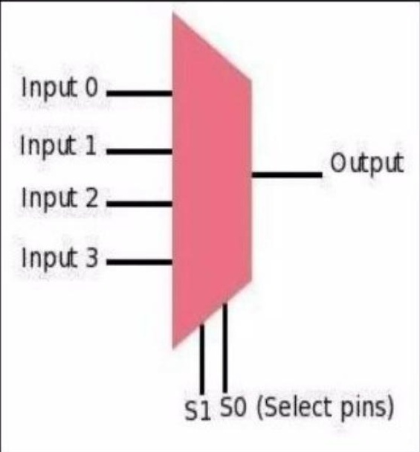
WHAT IS MULTIPLEXER???
Multiplexer is a device that has multiple inputs and a single line output.
The select lines determine which input is connected to output and also to increase the amount of data that can be sent over a network with certain time.
It is called as data selector.

Slide 3
MULTIPLEXER TYPES
2-1 Multiplexer (1 select line)
4-1 Multiplexer (2 select lines)
8-1 Multiplexer (3 select lines)
16-1 Multiplexer (4 select lines)

Slide 4
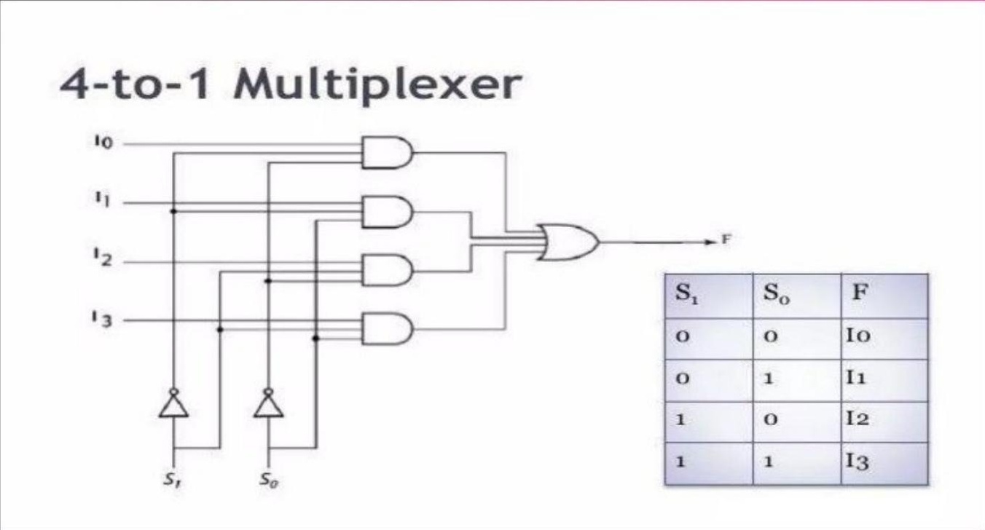
4 to 1 multiplexer

Slide 5

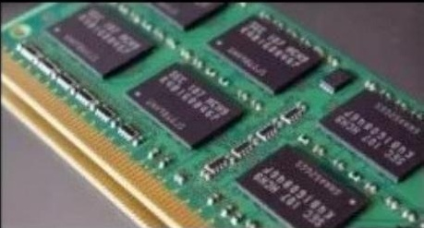
APPLICATIONS OF MULTIPLEXER
Communication System:
A communication system has a great impact by multiplexer.
By using a multiplexer, the efficiency can be increased.
Computer Memory:
Multiplexers are used in computer memory.
Reduces copper lines to connect the memory to other parts of the computer.

Slide 6
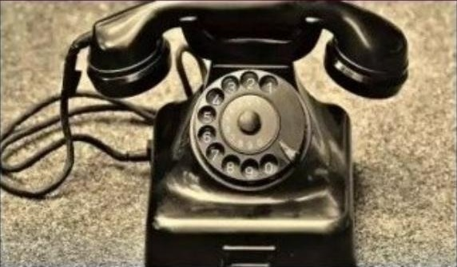
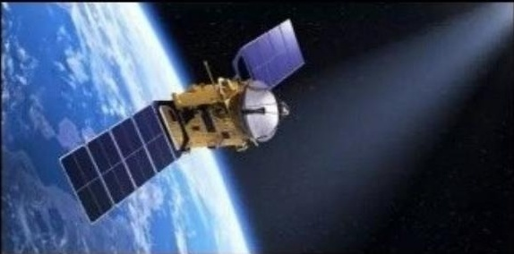
APPLICATIONS OF MULTIPLEXER
Telephone Network:
In telephone networks, multiple audio signals are integrated.
Transmission from the Computer of a Satellite:
Multiplexer is used to transmit the data signals.
From satellite to ground
By using GSM satellite.

Slide 7
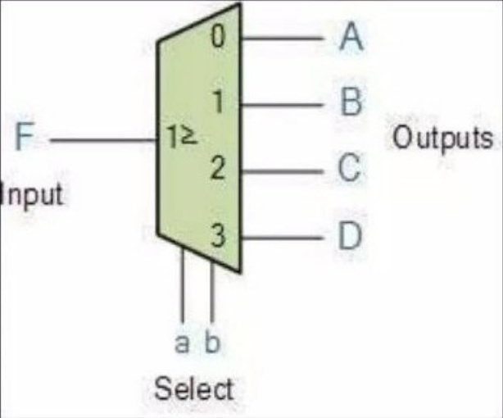
WHAT IS DEMULTIPLEXER???
De-multiplexer is also a device with one input and multiple output lines. It is used to send a signal to one of the many devices. The main difference between a multiplexer and a de-multiplexer is that a multiplexer takes two or more signals and encodes them on a wire, whereas a de-multiplexer does reverse to what the multiplexer does.

Slide 8
TYPES OF DEMULTIPLEXER
De-multiplexers are classified into four types:
1-2 demultiplexer (1 select line)
1-4 demultiplexer (2 select lines)
1-8 demultiplexer (3 select lines)
1-16 demultiplexer (4 select lines)

Slide 9
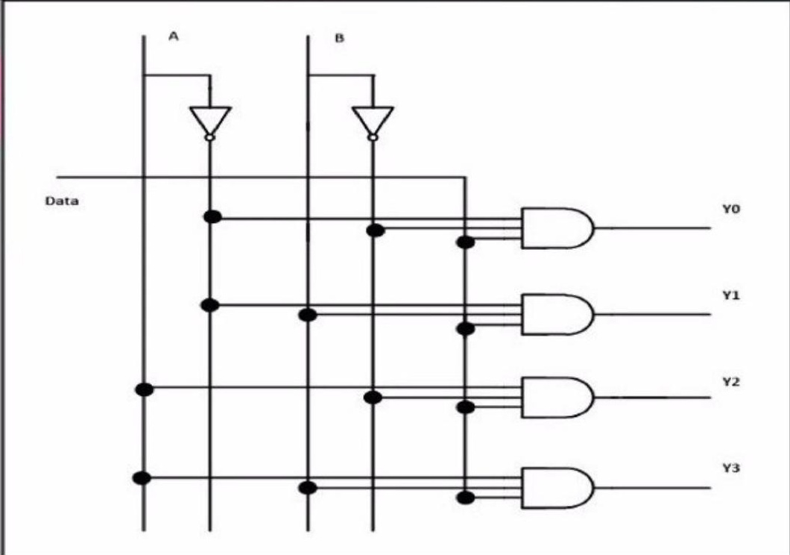
1-4 DEMULTIPLEXER
Truth Table
Input |  | Output
S0 | S1 | Y
0 | 0 | I0
0 | 1 | I1
1 | 0 | I2
1 | 1 | I3

Slide 10
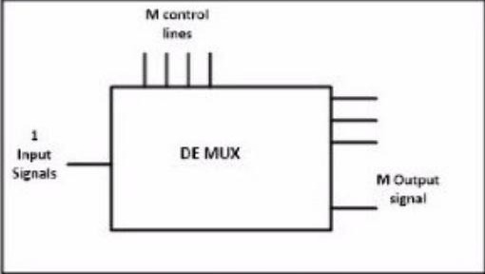
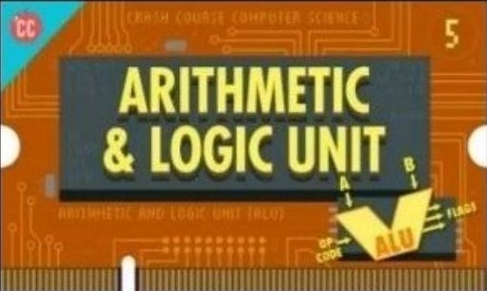
APPLICATIONS OF DEMULTIPLEXER
Communication System:
DE multiplexer receives signal outputs from the multiplexer.
At the receiver end it converts them back to the original form.
Arithmetic Logic Unit (ALU):
The output of the ALU is fed as an input to the DE multiplexer.
And the output of the DE multiplexer is connected to a multiple register.

Slide 11
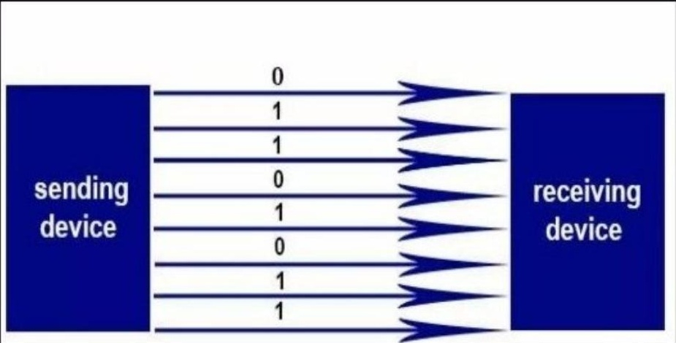
APPLICATIONS OF DEMULTIPLEXER
Series to parallel converter:
This converter is used to reconstruct parallel data.
Serial data is given as an input to the DE multiplexer at a regular interval.
A counter is attached to detect the data signal.

Slide 12
GitHub repository link
https://github.com/satyamverma6873-dotcom/satyam-verma

Slide 13
THANK YOU

